Slide 1

UNIVERSITY OF PETROLEUM & ENERGY STUDIES
School of Computer Science
Dehradun
COURSE: IT Security
July – December 2023
Delivered by
Dr. Gopal Singh Rawat
1

Slide 2
Course Plan
Introduction to IT System Security
Operating System Security
Endpoint Security
Application Server Security
Database Server Security
IT System Security Processes

Slide 3
Unit #4: Application Server Security

Slide 4
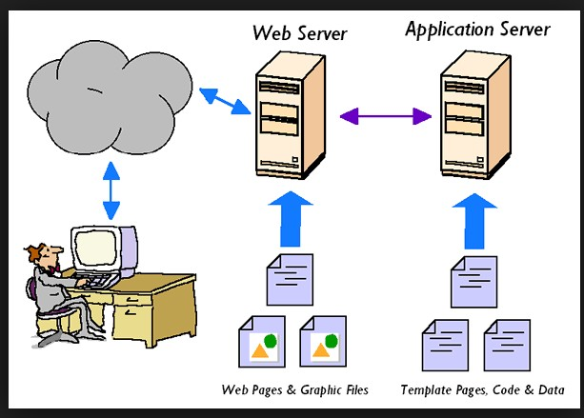
4.1 Application Server Security
What is an Application Server
Program running in a server (computer) that provides the business logic for an application.
This can be viewed as part of a three-tier structure →
1st Tier → consisting of a Web browser based graphical user interface (GUI) for clients to connect → Front end
Middle Tier → platform for application or business logic – can be set of modules/programs/APIs → Middleware
3rd Tier → Database and Transaction server → Back end

Slide 5
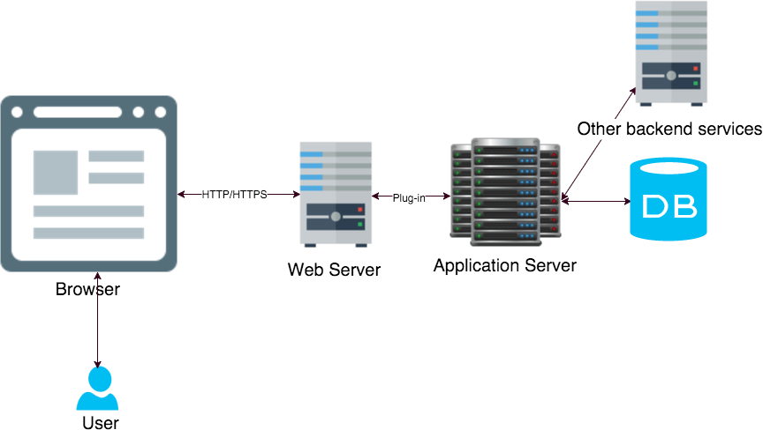
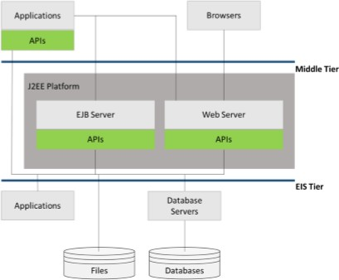
4.2 Application Server Architecture
Backend
Middleware
Client Front End
Client Front End
Middleware
Backend

Slide 6
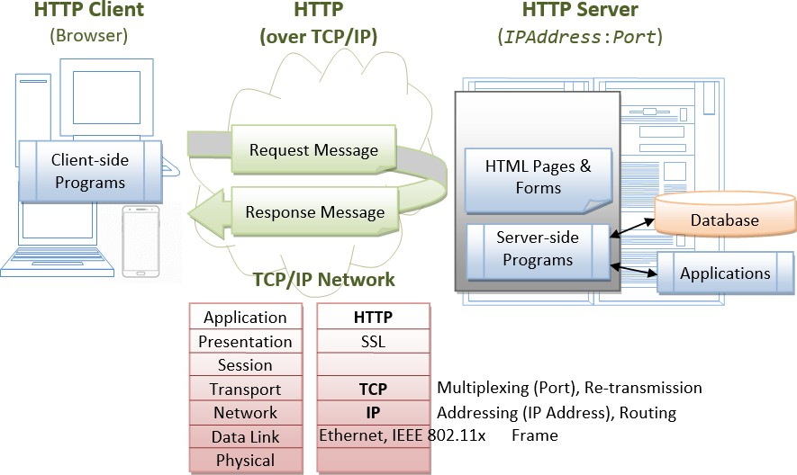
4.2 Application Server Architecture

Slide 7
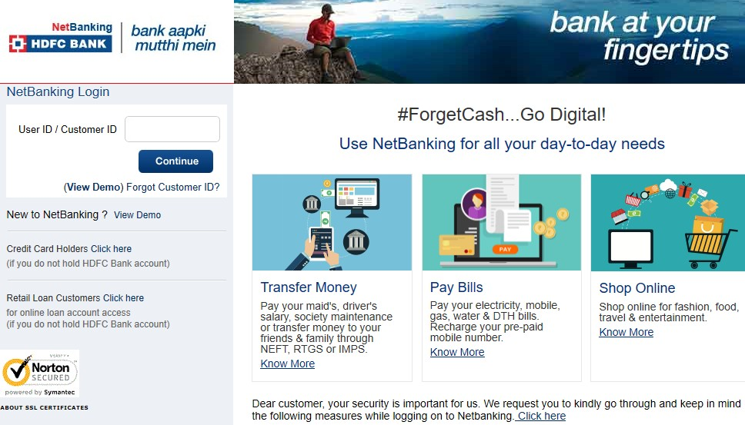
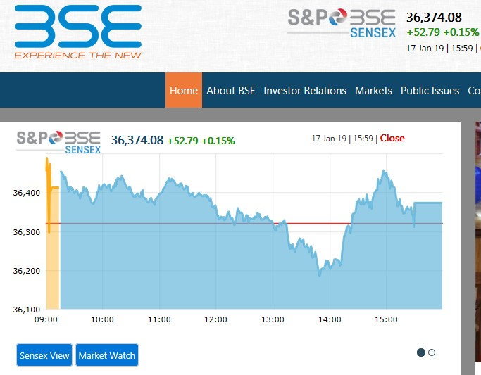
4.3 Difference between Web Server and Application Server:
Web Servers
Designed to serve static HTTP/HTTPS content → 1st page → landing page → Login, Information, Contact, Careers…
Have plugins to support scripting languages like Perl, PHP, ASP, JSP through which these servers can generate
dynamic HTTP content

Slide 8
4.3 Difference between Web Server and Application Server:
Application Server →
Can also serve HTTP Content but they are not limited to just HTTP.
App servers have a Web Server as an integral part of their portal
App Server can do whatever Web Server is capable of + integrate with database servers
App Server have components and features to support Application-level services or business logic →
Reverse Proxy – search, separate module for specific use
Filtering → profiling user access / data
Connection Pooling → get requests / connections → Store same type of requests in an array
Object Pooling → grouping instance of resources
Data Caching → storing frequently accessed data for quick retrieval
Clustering → schema objects from one or more tables which are similar
Load Balancing → manage user requests – round robin, least connection, source IP, Chained Failover
Transaction Support →interface with 3rd party applications
Messaging services → communication / alerting module
Application Server → acts as an additional layer of security
Notes:
https://www.cloudflare.com/learning/cdn/glossary/reverse-proxy/

Slide 9
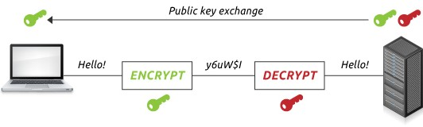
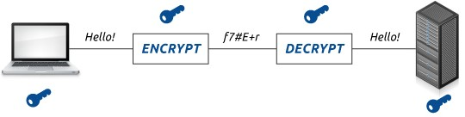
4.4 SSL Keys and Certificates
Online ecommerce Web Portals → Flipkart, Amazon, Firstcry →
Create a trusted environment where potential customers feel confident in making purchases.
SSL certificates create a foundation of trust by establishing a secure encrypted connection.
SSL allows sensitive information such as Credit card numbers, Social security numbers, Login credentials to be
transmitted securely.
Normally data sent between browsers and web servers is sent in plain text → vulnerable to eavesdropping.
If an attacker is able to intercept all data being sent between a browser and a web server, they can see and use that information → Solution → encrypt and secure the session between user and server
Asymmetric / Public Key Encryption Symmetric / Secret Encryption
Separate keys for encryption and decryption
1024 or 2048 BITS → 14 Billion years to crack
Same single key for encryption and decryption
128/256 BITS → 128 bit has
340,282,366,920,938,463,463,374,607,431,768,211,456
→ combination possibilities

Slide 10
4.5 Which Encryption Is Stronger?
Asymmetric keys → Bigger than Symmetric keys
Data that is encrypted Asymmetrically is tougher to crack as compared to data that is encrypted Symmetrically.
However, this does not mean that asymmetric keys are better.
Rather than being compared by their size, encryption value is validated as
Computational burden
Ease of key distribution
Symmetric keys → smaller than Asymmetric → so require less computational burden.
However, Symmetric keys also have a major disadvantage for securing data transfers.
Same key is used for symmetric encryption and decryption → both sender and receiver need the same key.
If you can walk/talk to the recipient about the key – then its fine. Else sending the key halfway around the world (a more
likely scenario) you need to worry about data security.
Asymmetric encryption doesn’t have this problem.
Two different keys are used here – as long as you keep your private key secret, no one can decrypt your messages.
You can distribute the corresponding public key without worrying who gets it.
Anyone who has the public key can encrypt data, but only the person with the private key can decrypt it.
Notes:
https://www.geeksforgeeks.org/difference-between-symmetric-and-asymmetric-key-encryption/

Slide 11
4.6 How Web Server uses Encryption
Public Key Infrastructure (PKI)
Set of Hardware, Software, People, Policies and Procedures
Create, manage, distribute, use, store and revoke keys and Digital Certificates
PKI is what binds keys with user identities by means of a Certificate Authority (CA)
PKI uses a hybrid cryptosystem to get benefits of both types of encryptions
Digital Certificates
Allows validation of a web server and the encryption of all communication between that server and its visitors.
Or, put another way, an SSL certificate is what facilitates encrypted connections.
Types:
Validation level – Domain validated certificates (X.509 digital certificate), Extended validation certificates (more detailed CA)
Functionality level – Encrypt –
Single → upes.ac.in
Multiple → Upes.ac.in, upes.in, upes.com, upes.co.in)
All Subdomains → Upes*.*
Multiple Domain wildcards → U*.*

Slide 12

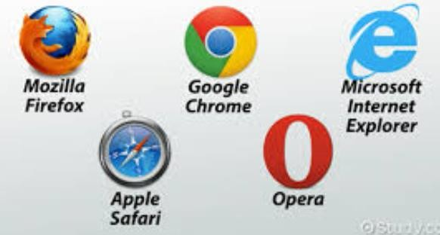
4.7 Secure Socket Layer (SSL) negotiation steps:
#1 Web Server send copy of Asymmetric public key to user
#2 Web Browser creates secure Symmetric session key, encrypts it with the server's asymmetric public key and sends to the Server
#3 Server decrypts the encrypted session key using its asymmetric private key to get the symmetric session key
User – Browser
Requests to open web site (URL)
#4 Server and Browser now encrypt and decrypt all transmitted data with the symmetric session key
Web and Application Server Responds to user requests
4.6 Examples of Encryption
Asymmetric Encryption: Public Key → RSA and ECC
Symmetric Encryption: Single Key → AES, DES , BlowFish

Slide 13
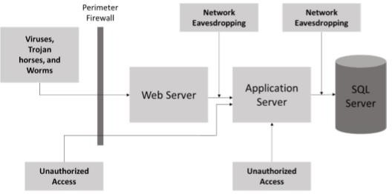
4.8 Web Application Server Threats

Slide 14
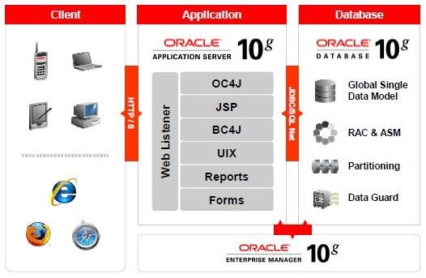
4.9 Oracle Application Server
Oracle Application Server is a part of the Oracle platform → complete and integrated e-business platform.
Oracle platform consists of:
Oracle Developer Suite for developing applications
Oracle Application Server for deploying Internet applications
Oracle Database Server for storing content
This runs Web sites, J2EE applications and Web services
Current version: 10G

Slide 15
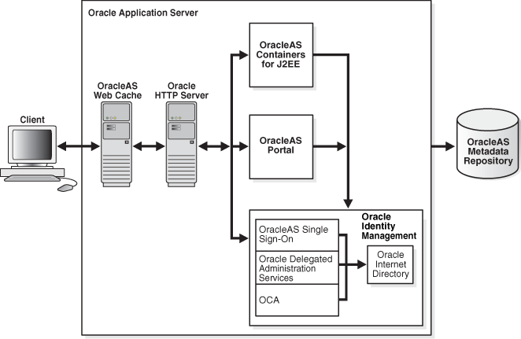
4.10 Oracle Application Server Security Architecture
Security Services provided by Oracle Server:
Authentication → verify identity of a user, program or system seeking to access data or other systems → Who is trying to access?
Authorization → determines privileges which users and other systems have for accessing resources on that system → Seek which services?
Access Control → grants access to resources only in ways consistent with security policies defined for those resources → How to access?
Data Protection → secures sensitive data against access by those who are not authorized users of the system → Encryption, Policy, Physical

Slide 16
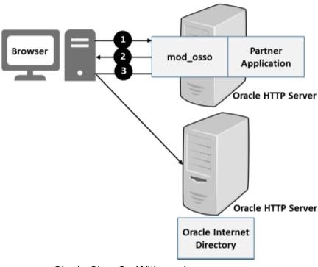
4.11 Oracle HTTP Server Security Architecture
Provides framework for hosting static/dynamic pages and apps over the web
Security infrastructure is primarily provided by
Apache modules → mod_auth_basic, mod_authn_file, mod_auth_user, and mod_authz_groupfile
Oracle modules → mod_ossl and mod_osso
Authentication →
pass the authenticated user-id to an application in a standard manner (SSO)
Uses mod_auth_basic, mod_authn_file, mod_auth_user, and mod_authz_groupfile
Authorization →
Allow server requester access to application for authenticated end user
Uses mod_authz_host
Encryption →
transparent SSL communication to end customers
X.509 Client certificates over SSL
Uses mod_osso for single sign-on to access Web applications.
Confidentiality →
Uses mod_ossl
URL Requests in Oracle HTTP Server

Slide 17
4.12 Oracle Application Server Security Best Practices
Best practices for HTTPS Use → HTTP over Transport Layer Security (TLS)
Configure Oracle Application Server to fail attempts that use weak encryption, use only specific ciphers
Use HTTPS to HTTP appliances for accelerating HTTP over SSL → throughput (transactions per second)
Ensure that sequential HTTPS transfers are requested through the same Web server
Keep secure pages and pages not requiring security on separate servers
Assign Lowest-Level Privileges Adequate for the Task to Contain Security Leaks – Principle of Least Privilege
Notes:
https://docs.oracle.com/cd/B14098_01/web.1012/b14013/jaashints.htm

Slide 18
4.13 Oracle Application Server Security Best Practices
Best Practices for Cookie Security
Cookies → small packets of data sent by Servers to user (your) browser
Read by JavaScipt → hackers like this a lot. ☺
Store configuration or personal data (Browsing habits → Dynamic web content), Reduce multiple server requests
Session or Persistent cookie
Secure Flag – cookie is encrypted
Set HTTPOnly Flag – prevents cookie from being read by JS & Disable Trace – developers during coding
Set SameSite Flag to Strict – added by Google for Chrome 51, no different links apart from the initial site
Leave HostOnly Flag Empty – specifies if the cookie is accessible by sub-domains or not
Ensure cookies have proper expiration dates → Session cookies
Use Method Authentication → ensure that cookie data has not been changed since the application set the data.
Ensure size and varieties of cookies is low → browser limit to send info, performance degradation
Carefully use cookie domain name using SameSite flag
Leave the Domain empty, to avoid subdomains from using the cookie.

Slide 19
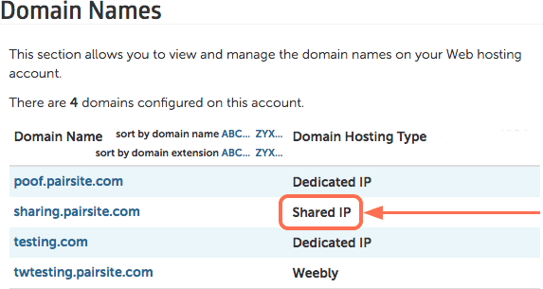
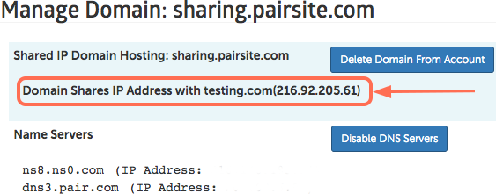
4.14 Oracle Application Server Security Best Practices
Best Practices for Certificates Use
Any site → correctly set up using SSL → falls into two categories:
Hosted Web Site has its own dedicated, not-shared IP address
Hosted Site shares an IP address with other sites that are SSL-enabled
Ensure that certificate organization unit plus issuer fields uniquely identify the organization across the Internet
Ensure that certificate issuer plus distinguished name uniquely identify the user
Include expiring certificates in tests of applications using certificates
Use certificate re-issues to update certificate information
Audit certificate revocations

Slide 20
4.15 Oracle Application Server Security Best Practices
Vulnerability Assessment and Penetration Testing (VA/PT) →
Review Source Code and Content Against Known Attacks → Tools
Follow Common Sense Security Practices
Default Deny → block all traffic initially, then allow only specific ports/IP addresses
Keep Configuration clear / short
Review Rules regularly
Document each Configuration Change Made
Log traffic but reducing Log Noise
Leverage Declarative Security
Oracle HTTP Server → Application security features
Don’t require application to be modified for Authentication, Authorization, Encryption → Slide#16

Slide 21
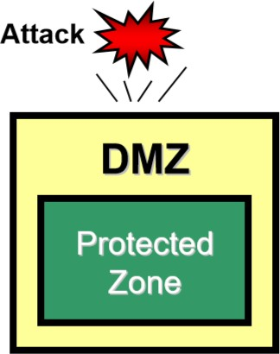
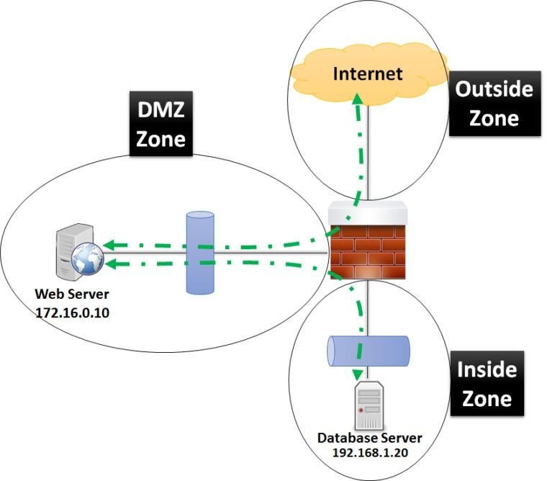
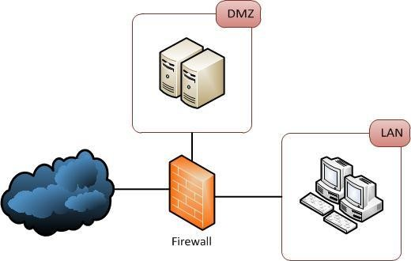
4.16 Demilitarized Zone (DMZ)
External-facing servers, resources and services are located in the DMZ.
Accessible from the internet, but the rest of the internal LAN remains unreachable.
Perimeter Network or Screened subnetwork → physical or logical subnet
Separate an internal local area network (LAN) from other untrusted networks (Internet).
Additional layer of security to the LAN → restricts hackers to directly access internal servers/data via the internet.
Unsecure Internet
Secure

Slide 22
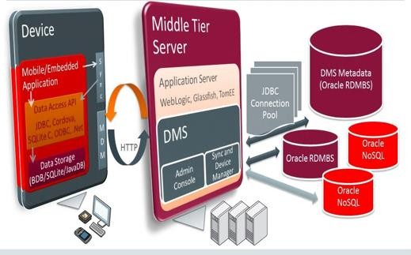
4.16 Web Application Server Security Best Practices
Use separate servers for internal and external applications
Use Separate Development Server for Testing and Debugging Apps – hosting zones → Alpha, Beta, UAT, Prod
Audit Web site activity and Store logs in a secure location
Education of developers on sound security coding practices
Patching Operating System and Web Server
Use of Application Scanners
4.17 Mobile Application Server
Client → HTTP/HTTPS → Web/Proxy Server → App Server → Database
Front End Middleware Backend

Slide 23
4.18 Types of Applications (from Security Testing perspective)
Web Servers
Program that uses HTTP (Hypertext Transfer Protocol) or HTTPS to serve user requests
Its generally designed in form of static files that form Web pages
Requests are forwarded to other systems by web servers – proxy, apps, database
Examples → Apache HTTP, Microsoft’s IIS, Apache Tomcat
Web Services
Apps built using different programming language for serving client requests
Standard platform for interoperability between disparate applications inside Server OS
Apps can be built using Java, Python, C++
Types of Web Services → API- SOAP and REST
Data is sent over apps by having HTTP using technologies such as XML, SOAP, WSDL, and UDDI
Thin Client Apps
Lightweight apps optimized for establishing a remote connection between server and client
Server infrastructure uses Cloud Computing - Application virtualization, hosted shared desktop (HSD)
Client connects using their browsers – Web-based or Terminal Server based
Thick Client Apps
Heavy, Robust, Connection/Security/Authentication/Encryption
Client Server architecture (SQL DB-Client)
Mobile Apps
Apps installed on mobile / handheld devices

Slide 24
4.19 Introduction to OWASP
O W A S P → Open Web Application Security Project
List of top 10 most critical Web Application Security Risks
Provides a description of each risk
Example of Vulnerabilities & Attacks
Mitigation strategies → Guidance to avoid these application security risks
Open Community, Free Project → checklist for fixing vulnerabilities for web portals and Applications
Security Researches, Teams or Ethical Hackers
Dave Wichers created OWASP Foundation in 2004, Aspect Security Co-founder & ED @ Ernest & Young
Link → https://www.owasp.org/index.php/Category:OWASP_Top_Ten_Project
What makes a Website Vulnerable?
Front End Scripting / Coding: JavaScript
Un-validated Client side redirects, Authentication, XSS Reflection, Cookies, Local Browser Storage
Backend Scripting Languages: Ruby, PHP
SQLi, Command Injection, Directory Traversal, File Uploads, Direct Object References

Slide 25
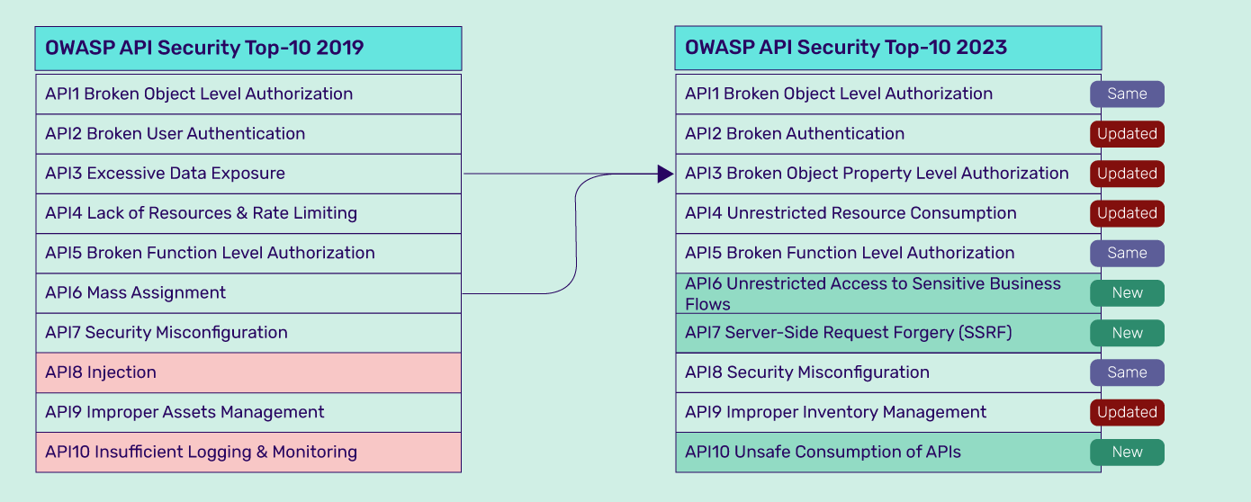
4.19 Introduction to OWASP

Slide 26
4.20 Identifying and Protecting data in mobile devices
Identify Sensitive Data
Data Sensitivity → Context-sensitive and depends on →
Regulation - which is often mandatory / Data Prioritization
Company Policy
Contractual Obligations
User Expectation
Note: Sensitive Data is not always user-generated input.
Can include data computed from scratch, data coming from external sensors (e.g., geolocation, data on mobile devices), cryptographic material and Personally Identifiable Information (PII).

Slide 27
4.21 Identifying and Protecting data in mobile devices
Protecting Sensitive Data → Policy
Secure Mobile Device Physically – never out of sight, Control, Accidental damage/loss/theft, Keep record of info
Control access to screen – PIN, Passwords, Lock Screen codes, Biometrics
Use Mobile Antivirus or Antimalware apps, Filters for Spam Calls/ SMS
Block / Deny access to Data/Contacts/Photographs to specified applications
Make Data Unreadable to others – Encryption
Limit Broadcasting Your Presence / Capabilities – Bluetooth, Hotspot, GPS, File Sharing
Beware of Free Wi-Fi
Phishing Emails, SMS or Calls – information disclosure, download malwares by offering free apps
Don’t Jailbreak your devices – Root the Hardware / Factory Default → use recommended OS and Apps only

Slide 28
4.22 Formidable apps
Harden the Mobile device
Mobile Device Management (MDM)
Enterprise Mobility Management (EMM)
Vendors - MobileIron, Airwatch, MaaS360, A4W
Application Wrapping – securely deploying apps
Use from only recommended / secure trusted sources
Apply App level Authentication / Access
Data at rest and in transit
VPN – encryption
Safe Browsing –
Anonymous Browsing
APIs → Secure Encryption
Prevent Cyber Attacks on device
Man-in-the-middle attacks
Malware attacks
Infected with Bot Scripts

Slide 29
4.23 Overview of Security Testing Tools
Application Security involves three major steps:
Threat Modeling
Understand the threats to which the apps are exposed – understand the environment, business, app logic
Makes it easier for businesses to comprehend the lurking danger and adopt countermeasures.
Penetration Testing
Approach the application just as any real-world hacker would as White Hats (Ethical Hackers).
Use Tools / Manual methods to hack apps, find vulnerabilities and get developers to patch them → Blue Team
External penetration testing should be performed by trustworthy individuals → Red Team
Source Code Review
Use static code analysis tools - FindBugs, Sonar, OWASP Orizon, Yasca, Spike
Manual source code review - manual hacking

Slide 30
4.23 Overview of Security Testing Tools
Top Application Security Tools:
ZAP – Zed Attack Proxy – web, apps, mobile security vulnerabilities
MicroFocus – mobile security testing – static code analysis & vulnerability scans across Client, Server & Network
Andriod Debug Bridge – CLI tool for Android Emulation and assess Security vulnerabilities across mobile apps
IBM App Scan
BurpSuite
Metasploit
Acunetix
Nessus
Nikto

